Slide 1

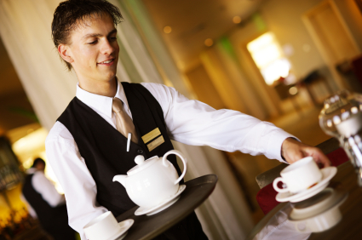
Converse in English at a basic operational level
Unit Code: D1.LAN.CL10.01
Notes:
Trainer to welcome class.

Slide 2

Converse in English at a basic operational level
This Unit comprises six Elements:
Participate in simple conversations on familiar topics with work colleagues
Respond to simple verbal instructions or requests
Make simple requests
Describe routine procedures
Express likes, dislikes and preferences
Identify different forms of expression in English.
Notes:
Trainer advises students this Unit comprises six Elements, as listed on the slide explaining:
Each element comprises a number of Performance Criteria which will be identified throughout the class and explained in detail
Students can obtain more detail from their Trainee Manual
The course presents advice and information but where their workplace requirements differ to what is presented, the workplace practices and standards must be observed

Slide 3

Assessment
Assessment for this Unit may include
Oral questions
Written questions
Work projects
Workplace observation of practical skills
Practical exercises
Formal report from employer/supervisor.
Notes:
Trainer advises students that assessment for this Unit may take several forms all of which are aimed at verifying they have achieved competency for the Unit as required.
Trainer indicates to students the methods of assessment that will be applied to them for this Unit.

Slide 4
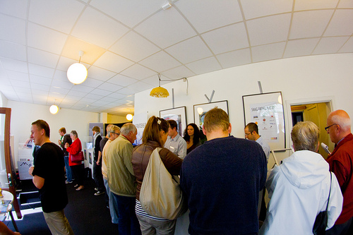
Participate in simple conversations on familiar topics with work colleagues
Performance Criteria for this Element are:
1.1 Use and respond appropriately to opening comments
1.2 Comment on familiar topics
1.3 Talk about a past event
1.4 Use closing remarks appropriately to end the conversation
Notes:
Trainer identifies the Performance Criteria for this Element, as listed on the slide.
Class Activity – General discussion
Trainer leads a general class discussion on conversations in the workplace, asking questions such as:
How often do you talk to colleagues at work?
What are some ways that you can start a conversation?
What kinds of things do you typically talk about?
Do you talk about very formal topics or topics that you know well?
What are some ‘familiar’ topics?
How do we talk about events that happened before now?
When you are finished talking, how do you end the conversation?

Slide 5
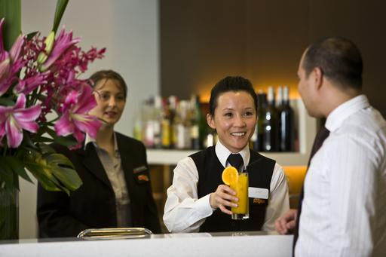
Responding to opening comments
Opening statements:
start a conversation
tell the listener the purpose of the conversation
give direction on how to continue the conversation.
Notes:
Trainer asks students how they approach someone if they want to talk to him/her. Trainer asks what kinds of things they usually say. Trainer calls on one particular student to ask about a conversation they had before class (this requires a little preparation before class). Trainer asks the student what he/she said to start the conversation and how that statement prepared the student to take part in the conversation.
Trainer explains to students that opening statements are very important because they:
start a conversation
tell the listener the purpose of the conversation
give direction on how to continue the conversation

Slide 6

Responding to opening comments
Understanding and responding appropriately to opening comments is very important at work.
Employees who are able to do this:
leave a good first impression.
communicate well with colleagues and customers.
Employees who are NOT able to do this:
may leave guests confused or upset
could contribute to miscommunication at work.
Notes:
Trainer explains the potential positive and negative consequences of opening statements in a professional setting.
Positive consequences include:
leaving a good first impression
communicating well with colleagues and customers
Negative consequences include:
possibly leaving guests confused or upset
contributing to miscommunication in the workplace

Slide 7

Responding to opening comments
Starting a conversation can be very stressful, but it can also be very rewarding. Here are some examples of opening statements to help you get started.
Examples:
How are you?
How’s the weather today?
How did your shift go?
Anything new today?
Notes:
Trainer tells students that starting a conversation can be stressful, but it can also be very rewarding. Trainer asks students why starting a conversation can be rewarding. Trainer explains that being a good conversation starter is a skill. Trainer asks students how this is an important skill at work and in their personal lives.
Trainer explains that opening statements help to start a conversation and gives some examples:
How are you?
How’s the weather today?
How did your shift go?
Anything new today?
Trainer asks students if they can think of any more examples of opening statements. Trainer writes these examples on the board.

Slide 8

Responding to opening comments
Some people get very nervous when starting a conversation. Here are some tips that will help make it easier:
Research interesting things to talk about
Relax
Be prepared to listen
Avoid complaining or gossip
Be yourself.
Notes:
Trainer acknowledges that starting conversations can make some people very nervous. Trainer explains that people in the hospitality industry must get over this fear. Trainer offers tips that can help them:
Research interesting things to say
Relax
Avoid complaining or gossip
Be yourself
Class Activity – Individual exercise
Trainer instructs students to match the opening statements to their appropriate responses in their Trainee Manual.

Slide 9

Responding to opening comments
In your Trainee Manual, write personal responses to the opening statements. Add your own for the final two.
How did your shift go today? ___________________
What’s the weather like? ___________________
What time is lunch? ____________________
(Add your own) _____________________?
(Add your own) _____________________?
Notes:
Class Activity - Individual
Trainer instructs students to write responses to the opening questions in their Trainee Manual. Students must also create two new opening statements and answer them.
Class Activity – Pair work
Students should practice asking these questions to a partner. When they are finished, they should swap roles.

Slide 10
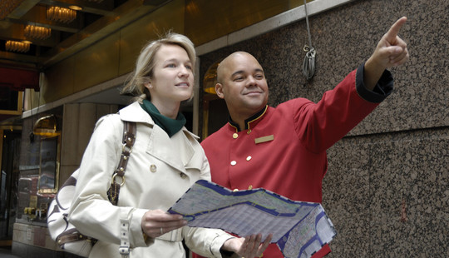
Talking about familiar topics
People in the service industry will often be required to provide assistance to guests or clients. This often includes:
giving directions
offering advice
taking care of a customer’s special needs.
Notes:
Trainer explains that employees in the service industry will often be required to provide assistance to customers. This includes:
giving directions
offering advice
taking care of a customer’s special needs

Slide 11

Talking about familiar topics
Giving directions is an everyday occurrence in hospitality. Employees should be familiar with prepositions of location/direction including:
into/out of
at the bottom of/at the top of
in front of/behind
along
past.
Notes:
Trainer explains that giving directions will be a big part of the students’ jobs. Trainer tells students that they should be familiar with prepositions of location/direction including:
into/out of
at the bottom of/at the top of
in front of/behind
along
past
Trainer asks students if they can think of any other words they use to give directions. Trainer instructs students to complete the prepositions of location/direction activity in their Trainee Manual.

Slide 12

Talking about familiar topics
You must also understand different ways to ask for directions. These include:
Where is __________________?
How do I get to __________________?
Can you tell me where the __________ is?
I’m looking for the ____________.
Notes:
Trainer tells students that they must first understand when someone is asking for directions in order to respond appropriately. Examples of ways to ask for directions include:
Where is _________?
How do I get to ____________?
Can you tell me where the ___________ is?
I’m looking for the _____________.
Class Activity – Pair work
Trainer instructs students to work in pairs to ask directions to 5 places in their workplace.

Slide 13

Talking about familiar topics
You will also be required to give advice to customers using ‘should’ and ‘ought to’.
Examples:
You should go to the Acme Restaurant for dinner
He ought to go to the museum today.
http://www.engvid.com/give-advice-should-ought-to-had-better/
Or
http://www.youtube.com/watch?v=00k85ENbak4
Notes:
Trainer explains that students will also be responsible for giving advice to customers. Trainer instructs students to give advice using:
should
ought to
Class Activity
Trainer instructs students to give advice to two other students in the class
Trainer uses video at: http://www.engvid.com/give-advice-should-ought-to-had-better/
Or
http://www.youtube.com/watch?v=00k85ENbak4

Slide 14

Talking about familiar topics
Employees must also be able to respond to customer complaints. In order to deal with complaints, take the following steps:
Apologize
Example: I’m sorry, sir/madam.
Attempt to solve the problem
Example: I will look into it immediately.
Alert a supervisor
Example: Just one minute, please. I will alert my supervisor.
Notes:
Trainer will outline the following steps to deal with customer complaints:
Apologize
Attempt to solve the problem
Alert a supervisor
Trainer instructs students to think of three complaints that they hear in their jobs.
Class Activity – Pair work
Trainer instructs students to work in pairs to do a roleplay with complaints.

Slide 15

Using the simple past tense
There are two types of verbs in the simple past tense: regular and irregular.
Regular
These types of verbs always end in –ed.
Irregular
No grammar rule. Must remember each verb.
Notes:
Trainer explains the difference between regular and irregular past tense verbs.
Regular Verbs:
end in –ed
Irregular Verbs:
have no specific grammar rule, students must remember each of them
Class Activity – Individual
Trainer instructs students to complete the grammar exercise in their Trainee Manual.

Slide 16

Using the simple past tense
Find Someone Who…
Example:
went hiking today.
Did you go hiking today?
Yes, I did. / No, I didn’t.
1. went hiking today. David .
Notes:
Class Activity – Mingling
Trainer explains the rules to Find Someone Who.
Students must mingle with their classmates to find out what people did in the past. Students should ask questions to each other, and write down one name for every positive answer. Students should not right down a name for negative answers. They should only write down the same name twice (depending on the number of students).

Slide 17

Ending the conversation
Closing down a conversation is an important part of the communication process.
If not done appropriately, it can be seen as:
rude
hurtful.
When ending a professional conversation, you want the other person to think the conversation was enjoyable.
Notes:
Trainer describes the importance of ending conversations. If not done appropriately, it can be seen as:
rude
hurtful
Trainer tells students that they should make the other person feel as if the conversation was enjoyable.

Slide 18
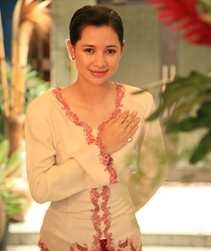
Ending the conversation
Two strategies can be used to end conversations appropriately:
Give a positive comment
Example: I hope you enjoyed your stay.
Outline a summary or plan
Example: I will meet you in the lobby at 8pm.
Notes:
Trainer outlines two strategies for ending conversations appropriately. These include:
giving a positive comment.
outlining a summary or plan.
Class Activity – Pair work
Trainer instructs students to complete the exercise in their Trainee Manual and read the dialogues in pairs.

Slide 19

Respond to simple verbal instructions or requests
Performance Criteria for this Element are:
2.1 Confirm understanding of supervisor’s instructions or requests
2.2 Request repetition or clarification of instructions or requests.
Notes:
Trainer identifies the Performance Criteria for this Element, as listed on the slide.
Class Activity – General discussion
Trainer leads a general class discussion on responding to instructions and requests, asking questions such as:
What does ‘instructions’ mean?
What kind of requests do you get at your job?
Is it always easy to understand instructions?
What is the last request you heard at your job?
What do you do if you can’t understand what your supervisor tells you?

Slide 20
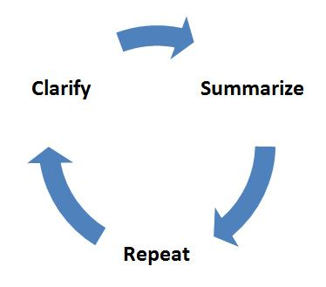
Confirming that you understand
When a supervisor or manager gives an employee instructions to carry out a task, they expect that it will be done correctly. It is the responsibility of the employee to clarify the instructions or request to ensure no miscommunication of the supervisor’s expectations.
When you are given instructions it is important to confirm that you understand them and respond appropriately.
Notes:
Trainer describes the importance of fully comprehending instructions or requests, as outlined on the slide. Trainer emphasizes the importance of confirming full comprehension and responding appropriately.

Slide 21

Confirming that you understand
There are two ways to confirm understanding:
Short responses
Example: Ok, I understand.
Body language
Example: Using thumbs up or OK hand gestures.
Notes:
Trainer describes two strategies to confirm understanding.
Short responses
Body language
Trainer provides examples of each and asks the students if they can think of any more.
Trainer instructs students to guess the meaning of the physical gestures in their Trainee Manual.
Class Activity - Gestures
Trainer makes four gestures (shake head, thumbs up, palms up, ok sign) and instructs students to write the meaning of the gestures in the Trainee Manual.
Class Activity - Listening
Trainer reads the instructions below and instructs students to write the instructions in the Trainee Manual.
Stand up and raise your hand.
Write your name on a piece of paper.
Touch your right foot.
Point your finger at the Trainer.
Walk to the door and come back to your seat.
Don’t forget to finish your homework.
Trainer then instructs students to work in pairs to give each other these instructions and confirm understanding.

Slide 22
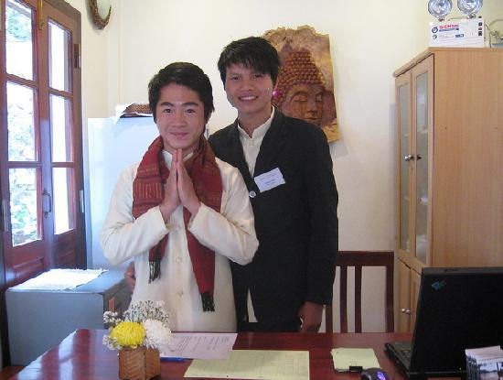
Requesting repetition or clarification
People often find it difficult to ask for repetition or clarification. However, asking for repetition or clarification will help you:
limit mistakes
improve efficiency at work.
Notes:
Trainer introduces this subject by giving students fast, complicated instructions to do something in the class. Trainer observes the students’ reaction and makes a note of students that ask him/her to repeat or clarify his instructions.
Trainer tells students that people often find it difficult to ask for repetition or clarification, and that this is considered a sign of incompetence in many cultures. Trainer emphasizes the importance of asking for repetition/clarification and states that it will:
limit mistakes at work.
improve efficiency at work.

Slide 23

Requesting repetition or clarification
If you can’t hear someone well, it is essential that you ask them to repeat themselves.
Here are some ways to ask for repetition:
Can you repeat that, please?
Would you mind saying that again?
Sorry, I missed that.
Notes:
Trainer instructs students to ask for repetition when they don’t hear the speaker well.
Trainer provides examples including:
Can you repeat that, please?
Would you mind saying that again?
Sorry, I missed that.
Trainer asks the students to think of additional ways to ask for repetition.

Slide 24

Requesting repetition or clarification
If you didn’t fully comprehend instructions or requests, it is essential that you ask for clarification.
Here are some ways to ask for clarification:
You would like me to…?
Can I make sure I understood correctly?
So, I should…?
Notes:
Trainer instructs the students to ask for clarification when they don’t completely understand the instructions.
Trainer provides examples including:
So, you would like me to…?
Can I make sure I understood that correctly?
So, I should…?
Trainer asks the students to think of additional ways to ask for clarification.

Slide 25

Requesting repetition or clarification
Question Activity
Arrange yourselves in a circle with all the other trainees. I will start the game by giving one person some instructions. That person can only respond with a question asking for repetition or clarification. Then, that person gives instructions to the trainee on his/her right, who responds with another question. The goal of the game is to go around the circle only responding with questions.
Notes:
Class Activity
Trainer describes the rules of the Question Game, as outlined on the slide.

Slide 26

Requesting repetition or clarification
Telephone Activity
Arrange yourselves in a line with all the other trainees. I will start the game by whispering a request to the first person. That person must whisper the same request to the next person in the line without allowing the others to hear it. You may NOT ask for repetition or clarification, and the request can only be said once. When the last person in the line hears the request, he/she says it out loud to the class.
Next, we will repeat the same activity, but every person may ask for repetition or clarification one time.
Notes:
Class Activity
Trainer describes the rules of the Telephone Game, as outlined on the slide.

Slide 27
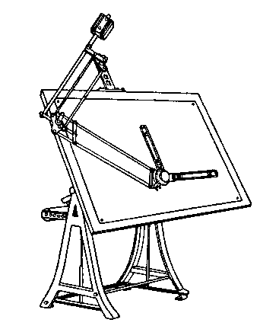
Requesting repetition or clarification
Picture Activity
You have five minutes to draw a simple picture on a piece of paper. It can be a landscape, house or person. When you are finished, sit next to your partner without showing him/her your picture. Give your partner instructions on how to draw your picture on a different sheet of paper. You may not show, him/her your picture. You must give very precise instructions in order for your partner to draw the same thing. He/she may ask for repetition or clarification as needed.
You have five minutes to complete the task. The pair with the most similar drawings wins.
Notes:
Class Activity
Trainer describes the rules of the Picture Game, as outlined on the slide.

Slide 28

Make simple requests
Performance Criteria for this Element are:
3.1 Use polite forms to make simple requests
3.2 Thank the person responding to your request
3.3 Acknowledge the person who cannot respond to your request.
Notes:
Trainer identifies the Performance Criteria for this Element, as listed on the slide.
Class Activity – General discussion
Trainer leads a general class discussion on making requests at work, asking questions such as:
Do you ever make requests to your customers?
What kinds of things do you ask them for?
What is the difference between ‘rude’ and ‘polite’?
What are some polite ways to ask for things?
How can you help guests that don’t speak your language or English?

Slide 29

Making requests
Using polite forms to make simple requests plays an important role in your overall presentation of yourself. When you are polite, you appear gracious, agreeable and pleasant.
Like many other languages, degrees of politeness exist in English, and you must understand which one to use depending on the circumstances and the person you are addressing. Also take into account what you are asking for. If it is a big request, it will require more formal language.
Notes:
Trainer emphasizes the importance of making polite requests in English, telling the students it can make them seem:
gracious
agreeable
pleasant
Trainer asks students if there is a degree of politeness in their language. Trainer explains that one exists in English and pay attention to the following criteria in order to determine which structure to use:
circumstances
status of person
kind of request being asked

Slide 30

Making requests
Degrees of politeness
Less formal Will you give me an apple?
Can I have an apple?
Could I have an apple?
Would you give me an apple?
Would it be OK if I got an apple?
I wonder if you could give me an apple?
Would you mind giving me an apple?
Most formal I was wondering if you could give me. an apple?
Notes:
Discuss the degrees of politeness above and practice them in pairs. In which circumstances and with whom are the different phrases likely to be used?

Slide 31

Making requests
Look at the requests and write down the appropriate way of asking for it.
Example: You want to borrow a friend’s camera.
Request: Can I borrow your camera?
Notes:
Class Activity - Dialogues
Trainer instructs the students to read the dialogues in their Trainee Manual, circle the requests, and decide if they are formal or informal. Trainer then instructs students to work in pairs in order to do role plays with the dialogues.
Class Activity
Trainer instructs students to write the proper requests in their Trainee Manual. Trainer then instructs students to make one new formal and informal request to other trainees in the class.

Slide 32
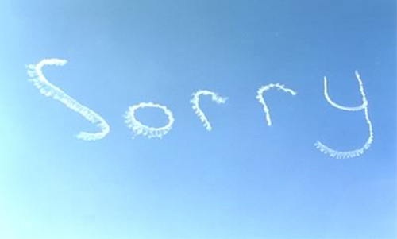
Saying ‘Thank You’
Expressing gratitude is a language tool that has important social value in English.
When you express gratitude you evoke feelings of warmth and solidarity
When you fail to express gratitude it can result in negative feelings and consequences.
Notes:
Trainer expresses the importance of showing gratitude in English, noting:
When you express gratitude you evoke feelings of warmth and solidarity.
When you fail to express gratitude it can result in negative feelings and consequences.

Slide 33

Saying ‘Thank You’
There are many ways to say ‘Thank You’ in English. Here are a few:
Thanks
Thanks a lot
Thank you very much
I appreciate that.
How to say 'Thank You‘
http://www.engvid.com/polite-english-8-ways-to-say-thank-you/
Notes:
Trainer explains that there are many ways to say ‘Thank You’ in English, noting that the appropriate way depends on the situation.
Thanks
Thanks a lot
Thank you very much
I appreciate that
Trainer asks if students can think of any additional ways to say ‘Thank You’.
Trainer shows video.

Slide 34
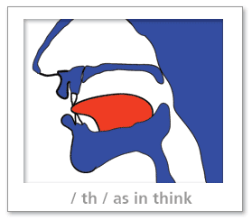
Saying ‘Thank You’
Pronunciation of the ‘th’ sound can be very difficult. It can be made by putting your tongue between your teeth so that the tip of your tongue is touching the tips of your top teeth. You should be able to see your tongue when you say words such as this, the, and that. If you cannot see your tongue, you may be putting your tongue behind your top teeth instead of touching the tips of your top teeth.
Notes:
Trainer conducts pronunciation exercises with the ‘th’ sound, instructing the students to touch the tip of their tongue to their top teeth in order to do it properly.
Class Activity – Individual
Trainer instructs students to write the appropriate form of gratitude next to the scenarios in their Trainee Manual.

Slide 35

Acknowledging all guests
Many guests will not be able to speak your language or English. It is important to acknowledge these guests and communicate with them in any way possible.
Follow these steps if you have trouble:
Remain calm
Repeat the question/statement slowly
Judge their comprehension by his/her response
Use body gestures to communicate
Ask them to wait
Alert a supervisor.
Notes:
Trainer instructs students to take the following steps if they are having problems communicating with guests:
Remain calm
Repeat the question/statement slowly
Judge comprehension
Use body gestures
Ask the guest to wait
Alert a supervisor

Slide 36
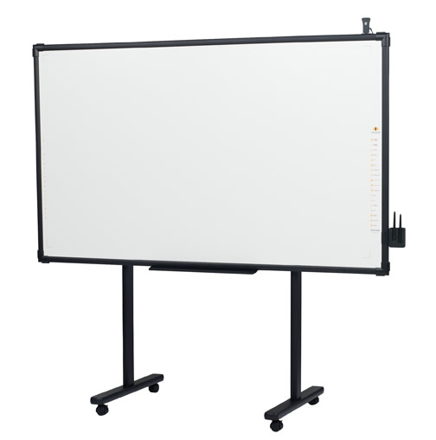
Acknowledging all guests
Back-to-the-Board Activity
Make two teams. I will write a request or vocabulary word on the board, while one person sits with his/her back to the board (without seeing the word/request). This person’s team must work together to make him/her say the word or request. The team has one minute to achieve this task before the next team goes.
After one round of the game, we will change the rules so that the person in the front of the class knows the word/request and must explain it to his/her team.
Notes:
Class Activity
Trainer describes the rules of the Back-to-the-Board Game, as outlined on the slide.

Slide 37

Acknowledging all guests
Charades Activity
Without talking, you must work with a partner to identify 10 vocabulary words on these notecards. All trainees will have the same notecards face-down on a desk between the pairs. One partner looks at the notecards and mimes the words, the other must say the word on the notecard. You must take turns acting out the vocabulary words without talking. The pair with the most identified words within five minutes wins.
Notes:
Class Activity
Trainer describes the rules of the Charades Game, as outlined on the slide. Trainer must prepare notecards before class.

Slide 38

Describe routine procedures
Performance Criteria for this Element are:
4.1 Explain a sequence of events in carrying out a routine job
4.2 Describe exceptions to routine procedures
4.3 Make suggestions on how to improve routine procedures.
Notes:
Trainer identifies the Performance Criteria for this Element, as listed on the slide.
Class Activity – General discussion
Trainer leads a general class discussion on routine procedures, asking questions such as:
What kinds of things do you usually do at work?
Do you ever have to give instructions?
If yes, how do you organize the instructions so people can understand them?
What are adverbs of frequency? Why do we use them?
I want to eat at a nice restaurant tonight. Can you suggest somewhere to go?
Is this the same kind of suggestion you would give at work? How is it different?

Slide 39
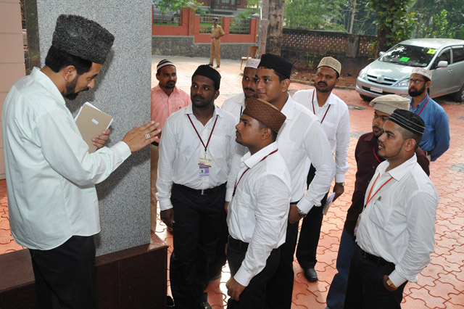
Giving instructions
Explaining how to carry out a routine job is a basic English task and can be used on a daily basis in the service industry.
Use sequence markers while giving instructions to indicate an order of the tasks to be performed.
Examples include:
first
then
next
finally.
Notes:
Trainer illustrates the importance of giving clear instructions. Trainer instructs students to use sequence markers to organize their instructions. These include:
first
then
next
finally
Trainer asks students if they can think of any more examples of sequence markers.

Slide 40

Giving instructions
Put the instructions in order.
Make a cocktail
___ Then add three measures of tonic.
___ First, pour one shot of gin into the glass.
___ Finally, put a slice of lime on the glass and insert a straw.
___ Next, mix the liquids well.
___ After that, add ice to chill the liquids.
Notes:
Class Activity - Listening
Trainer instructs students to listen to his instructions (below) and put them in order in their Trainee Manual.
Make a cocktail
First, pour one shot of gin into the glass.
Then add three measures of tonic.
Next, mix the liquids well.
After that, add ice to chill the liquids.
Finally, put a slice of lime on the glass and insert a straw.
Check-in a guest
First, welcome the guest.
Then ask for the name on the reservation.
Next, check the computer system for the reservation.
Then confirm the details.
Ask for the guest’s credit card.
Then give the guest his/her room key.
Finally, ask if the guest needs help with the luggage.
Class Activity - Individual
Trainer instructs students to use sequence markers in order to write three sets of instructions in their Trainer Manual.
Class Activity - Group
Trainer instructs students to work in small groups to write instructions on how to make one kind of local food. Students will read the instructions to the class.

Slide 41

Describing exceptions
In any work situation, unforeseen things occur that make you adjust your plan and disrupt your usual routine. Working in the hospitality industry requires individuals to be flexible and prepared to handle difficult and surprising situations.
You must be able to describe these exceptions in a professional manner and instruct co-workers how to deal with them.
Notes:
Trainer explains that surprises often occur in the hospitality industry that force people to change their plans. Trainer stresses the importance of being able to describe these situations.
Trainer asks the class for examples.

Slide 42

Describing exceptions
Use adverbs of frequency to talk about how often certain actions occur.
Examples include:
always
often
sometimes
never.
Notes:
Trainer instructs students to use adverbs of frequency to describe exceptions to routine procedures. Examples include:
always
often
sometimes
never
Trainer asks students to think of more examples of adverbs of frequency.

Slide 43

Describing exceptions
Adverbs of frequency should go directly before the verb when constructing a sentence. One exception is the adverb sometimes, which can also go at the beginning of a sentence.
Examples:
I always wake up early.
Mike never wants to play tennis.
Sometimes I like to go swimming.
Notes:
Trainer describes the grammatical structures used for adverbs of frequency, noting that sometimes can be used at the beginning of the sentence.
Class Activity – Individual
Trainer instructs students to write about their typical day using adverbs of frequency in their Trainee Manual.
Class Activity – Pair work
Trainer instructs students to write about their typical day using adverbs of frequency in their Trainee Manual

Slide 44

Describing exceptions
Use ‘How often’ to ask about frequency.
Examples:
How often do you watch movies?
How often does he eat apples?
How often do you come here?
Notes:
Trainer describes how to ask about the frequency of an action using ‘How often’.
Class Activity – Individual
Trainer instructs students to list activities they do at work in their Trainee Manual.
Class Activity – Pair work
Trainer instructs students to work in pairs and ask each other about the frequency of these activities. Students should write their partner’s responses in their Trainee Manual.

Slide 45

Making suggestions
As a member of the service industry you play a role in that growth and improvement. If you have suggestions on ways to improve routine procedures you should share them.
What are some problems at your workplace?
Notes:
Trainer introduces the topic by describing his/her ideal working environment.
Class Activity – Group discussion
Trainer asks students to describe their ideal working environment.
Trainer explains that students should feel confident about sharing their opinions on ways to improve working conditions.
Class Activity
Trainer asks students to brainstorm problems with their current workplace and write five of them down in their Trainee Manual.

Slide 46
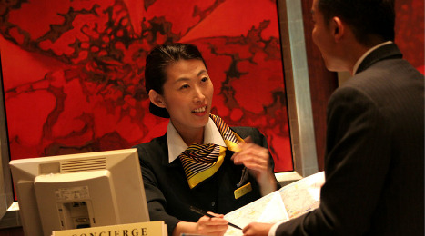
Making suggestions
In order to make suggestions in a professional setting, you must have the language skills to express your ideas without being offensive. Use formal or indirect language to accomplish this.
Examples:
Why don’t we…?
It might be a good idea to…
We should consider…
Notes:
Trainer explains that students must be professional when making suggestions so they are not seen as being rude or pushy.
Trainer gives examples of appropriate structures, including:
Why don’t we…?
It might be a good idea to…
We should consider…
Trainer asks the students to brainstorm other appropriate ways to make suggestions.
Class Activity – Individual
Trainer instructs the students to use this language to write suggestions to the problems they listed in the first activity.
Class Activity – Listening
Trainer instructs the students to listen to him/her describe problems (below) and write suggestions to improve them in their Trainee Manual.
Employees in the hospitality industry often change jobs.
Sometimes hotel staff don’t know how to use a computer.
It is difficult for many employees to learn English.

Slide 47

Express likes, dislikes and preferences
Performance Criteria for this Element are:
5.1 Talk about likes and dislikes of familiar topics and situations
5.2 Discuss preferences and give reasons.
Notes:
Trainer identifies the Performance Criteria for this Element, as listed on the slide.
Class Activity – General discussion
Trainer leads a general class discussion on likes, dislikes and preferences, asking questions such as:
Brainstorm some things that you like.
Brainstorm some things that you don’t like.
Is ‘I love’ the same as ‘I like’? What is the difference?
Ok, raise your hand. Who prefers chocolate to vanilla? Oranges to apples? Spring to summer?
Why?

Slide 48
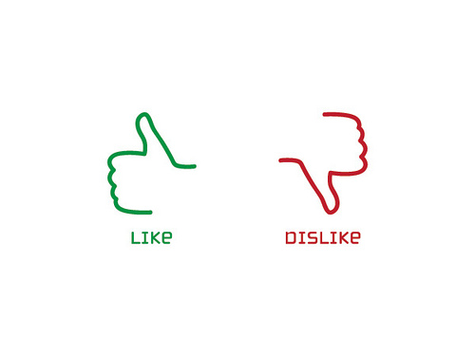
Likes and dislikes
Expressing your opinion is an important language skill, especially in the workplace. Talking about things you like and dislike is the easiest way to make connections with colleagues and customers, which will improve your professional relationships. You will also use this skill to:
help customers
give advice
relay personal experiences
make small talk.
Notes:
Trainer emphasizes the importance of the students voicing opinions at work, particularly on like and dislikes. Trainer notes that they will use this skill to:
help customers
give advice
relay personal experiences
make small talk

Slide 49

Likes and dislikes
Use the present simple tense to talk about the things you like, people you like, and activities you enjoy doing. Also use the present simple tense to talk about things or people you don’t like.
There's a whole range of English expressions you can use to talk about how much you like or dislike something.
Look at p. 52 in your Trainee Manual.
Notes:
Trainer tells the students to use the present simple tense when describing likes and dislikes. Trainer instructs students to look at the relevant exercise in the Trainee Manual and read the expressions as a class. Trainer asks if students can think of any additional expressions to express likes or dislikes.

Slide 50

Likes and dislikes
To talk about your general likes or dislikes, follow this pattern: like something or like doing something.
Be careful where you use very much or a lot. These words should go after the thing that you like.
When speaking generally, it's best to use plurals with countable nouns.
Examples:
I like eating apples.
I hate storms.
Notes:
Trainer goes over the grammatical structures used when expressing likes or dislikes, as outlined on the slide.
Class Activity – Individual
Trainer instructs students to express their likes and dislikes using the prompts in their Trainee Manual.

Slide 51

Likes and dislikes
Find Someone Who…
Example:
likes fried chicken.
Do you like fried chicken?
Yes, I do. / No, I don’t.
1. likes fried chicken. David .
Notes:
Class Activity – Mingling
Trainer explains the rules to Find Someone Who.
Students must mingle with their classmates to find out what people like. Students should ask questions to each other, and write down one name for every positive answer. Students should not right down a name for negative answers. They should only write down the same name twice (depending on the number of students).

Slide 52

Preferences and reasons
There are many ways to express preference in English. Pay attention to the formality of the situation in order to determine which structure is appropriate. In more formal circumstances, use modal verbs.
Examples:
I prefer apples.
I would prefer apples.
I would rather have apples.
Notes:
Trainer explains that the ability to state preferences and give opinions is a necessary skill for employees in any profession. Trainer describes the grammatical structures used to state preference and explains the level of formality for each one.
I prefer apples.
I would prefer apples.
I would rather have apples.
Class Activity – Individual
Trainer instructs students to use this language to state their preference on a variety of topics in their Trainee Manual.
Class Activity
Trainer asks students why they prefer certain things and notes how students give reasons.

Slide 53
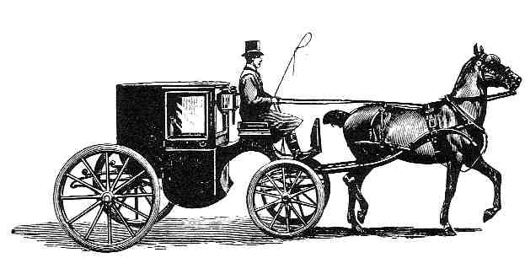
Preferences and reasons
After expressing your preferences you must support your statements in a logical, professional manner. A professional opinion without evidence to support it is like a carriage without a horse.
Notes:
Trainer explains the importance of giving reasons to support preferences, noting that preferences with support are like carriages without horses.
Class Activity - Individual
Trainer instructs students to read three passages in their Trainee Manual and circle the reasons given for the preferences.
Class Activity – Pair work
Trainer instructs students to work with a partner to give preferences and reasons for one topic listed in the Trainee Manual.

Slide 54

Identify different forms of expression in English
Performance Criteria for this Element are:
6.1 Construct a formal sentence
6.2 Identify indicators of informal expressions in English
6.3 Differentiate between ‘open-ended’ and ‘closed’ questions.
Notes:
Trainer identifies the Performance Criteria for this Element, as listed on the slide.
Class Activity – General discussion
Trainer leads a general class discussion on forms of expression in English, asking questions such as:
When should you use formal language?
When is it OK to use informal language?
What are some ways to make sentences more formal?
What is the difference between ‘open-ended’ and ‘closed’ questions?

Slide 55

Formal expressions
Formal English is a way of speaking that you use when you don't know the people listening to you very well. You also tend to use it more with people who are higher status and who you want to impress.
In formal English, people usually:
pronounce words more carefully. For example, in casual speech, people sometimes don't pronounce the "g" sound at the end of words ending in "-ing". In formal speech, people are more careful to pronounce this
don't use as many contractions (it's, they're, I'm)
use more modal verbs to show formality.
Notes:
Trainer describes when it is appropriate to use formal English. Trainer also illustrates how people often construct formal sentences:
pronounce words more carefully
don’t use contractions
use more modal verbs

Slide 56

Formal expressions
A modal verb is a type of supporting verb that is used to indicate likelihood, ability, permission, and obligation. Modal verbs give more information about the function of the main verb that follows it.
Modal verbs are different from normal verbs because:
they don’t use an ‘s’ for the third person singular
they make questions by inversion
they are followed directly by the infinitive of another verb.
Notes:
Trainer explains the grammatical function of modal verbs, noting that modal verbs:
don’t use an ‘s’ for the third person singular
make a question by inversion
are followed directly by the infinitive of another verb

Slide 57
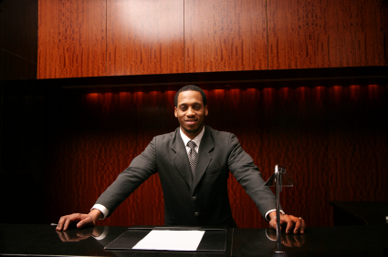
Formal expressions
Modal verbs include can, could, will, would, may, might, must, shall, should, ought to.
Modal verbs express:
probability
ability
obligation
advice
permission.
Notes:
Trainer gives examples of modal verbs and explains their function (see Trainee Manual):
probability
ability
obligation
advice
permission
Trainer instructs students to read this chart together as a class.
Class Activity – Individual
Trainer instructs students to change the questions listed in the Trainee Manual from informal to formal.
Class Activity – Individual
Trainer instructs students to write formal questions to the responses listed in the Trainee Manual.
Class Activity – Pair work
Trainer instructs students work in pairs in order to practice the dialogues together.

Slide 58

Informal expressions
When and where are informal expressions appropriate?
There are many situations in everyday life where informal English is allowed, even preferred. Some examples include chatting with a co-worker, talking on the phone to a friend, and watching television with your family.
Notes:
Trainer asks students when informal expressions are appropriate. Trainer then explains the types of social interactions in which they are appropriate.
Classroom Activity – Individual
Trainer instructs students to read the dialogues in the Trainee Manual and circle examples of informal speech.
Classroom Activity
Trainer asks students to defend their answers.
Classroom Activity – Pair work
Trainer instructs students to work with a partner to practice saying the dialogues together.

Slide 59

Informal expressions
Informal greetings and responses often include slang that is indicative of the casual situation in which it is used. These types of phrases should never be used in a professional setting, but they can be quite useful when speaking to family, close acquaintances or friends.
Examples:
How’s it going?
You doing OK?
What’s up?
Good for you.
Notes:
Trainer explains when students should use informal expressions and gives examples.
How’s it going?
You doing OK?
What’s up?
Good for you.
Trainer asks students to name additional informal expressions and lists them on the board. Trainer instructs students to read the chart in the Trainee Manual as a class.
Class Activity – Individual
Trainer instructs students to circle the informal expressions listed in their Trainee Manual.
Class Activity – Pair work
Trainer instructs students to work with partners to create a dialogue that includes at least 4 informal expressions. Students read the dialogues to the class.

Slide 60

Open-ended vs. Closed questions
There are two types of questions in English:
An open-ended question requires an answer greater than a single word or two
A closed question can be answered with a simple "Yes," "No," or other very simple answer.
Understanding what the question calls for can be the difference to having a successful interaction and not.
Notes:
Trainer explains the difference between open-ended questions and closed questions.
An open-ended question requires an answer greater than a single word or two.
A closed question can be answered with a simple "Yes," "No," or other very simple answer.
Trainer emphasizes that understanding the difference is a very important part of communicating in English.

Slide 61

Open-ended vs. Closed questions
Open-ended questions are those that solicit additional information from the enquirer. By definition, they are broad and require more than one or two word responses.
Examples:
How are you today?
How was your stay?
Why did you do this?
What are you looking for?
Notes:
Trainer further explains the function of open-ended questions and offers examples.
How are you today?
How was your stay?
Why did you do this?
What are you looking for?
Trainer asks the students to brainstorm more examples of open-ended questions.

Slide 62

Open-ended vs. Closed questions
Closed questions are those that can be answered finitely by either “yes” or “no.” Closed-ended questions can include presuming, probing, or leading questions.
Examples:
May/Can I help you?
Can I get you something, sir/madam?
Could you help me?
Are you enjoying yourself?
Notes:
Trainer further explains the function of closed questions and offers examples.
May/Can I help you?
Can I get you something, sir/madam?
Could you help me?
Are you enjoying yourself?
Trainer asks the students to brainstorm more examples of closed questions.
Class Activity – Individual
Trainer instructs students to read a dialogue in the Trainee Manual and determine whether the questions asked are open-ended or closed.
Class Activity – Pair work
Trainer instructs students to work in pairs to practice reading the dialogue together.

Slide 63
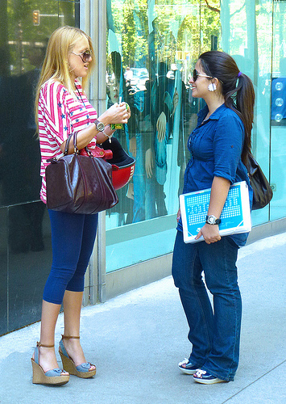
Open-ended vs. Closed questions
Question words can often indicate what information is required.
Open-ended questions often begin with the words WHAT, HOW, and WHY
Closed questions often begin with the words WHEN, WHERE, and WHO
View question chart in Trainee Manual.
Notes:
Trainer describes the question words used to form open-ended and closed questions.
Open-ended questions often begin with the words: WHAT, HOW, and WHY.
Closed questions often begin with the words: WHEN, WHERE, and WHO.
Trainer asks the students why they would use certain types of questions at certain times.
Trainer instructs students to read the question chart in the Trainee Manual.
Class Activity – Individual
Trainer instructs students to fill in the blanks to the questions in the Trainee Manual and specify if the question is open-ended or closed.
Class Activity – Pair work
Trainer instructs students to work in pairs to practice reading the questions together.
Class Activity – Individual
Trainer instructs students to write two open-ended questions and two closed questions in their Trainee Manual.
Class Activity – Pair work
Trainer instructs students to ask a partner these questions and record their answers.

Slide 64

Finish: Thank you!
Notes:
This is the conclusion of the subject.
Thank the audience and deliver assessments as required.

